Slide 1
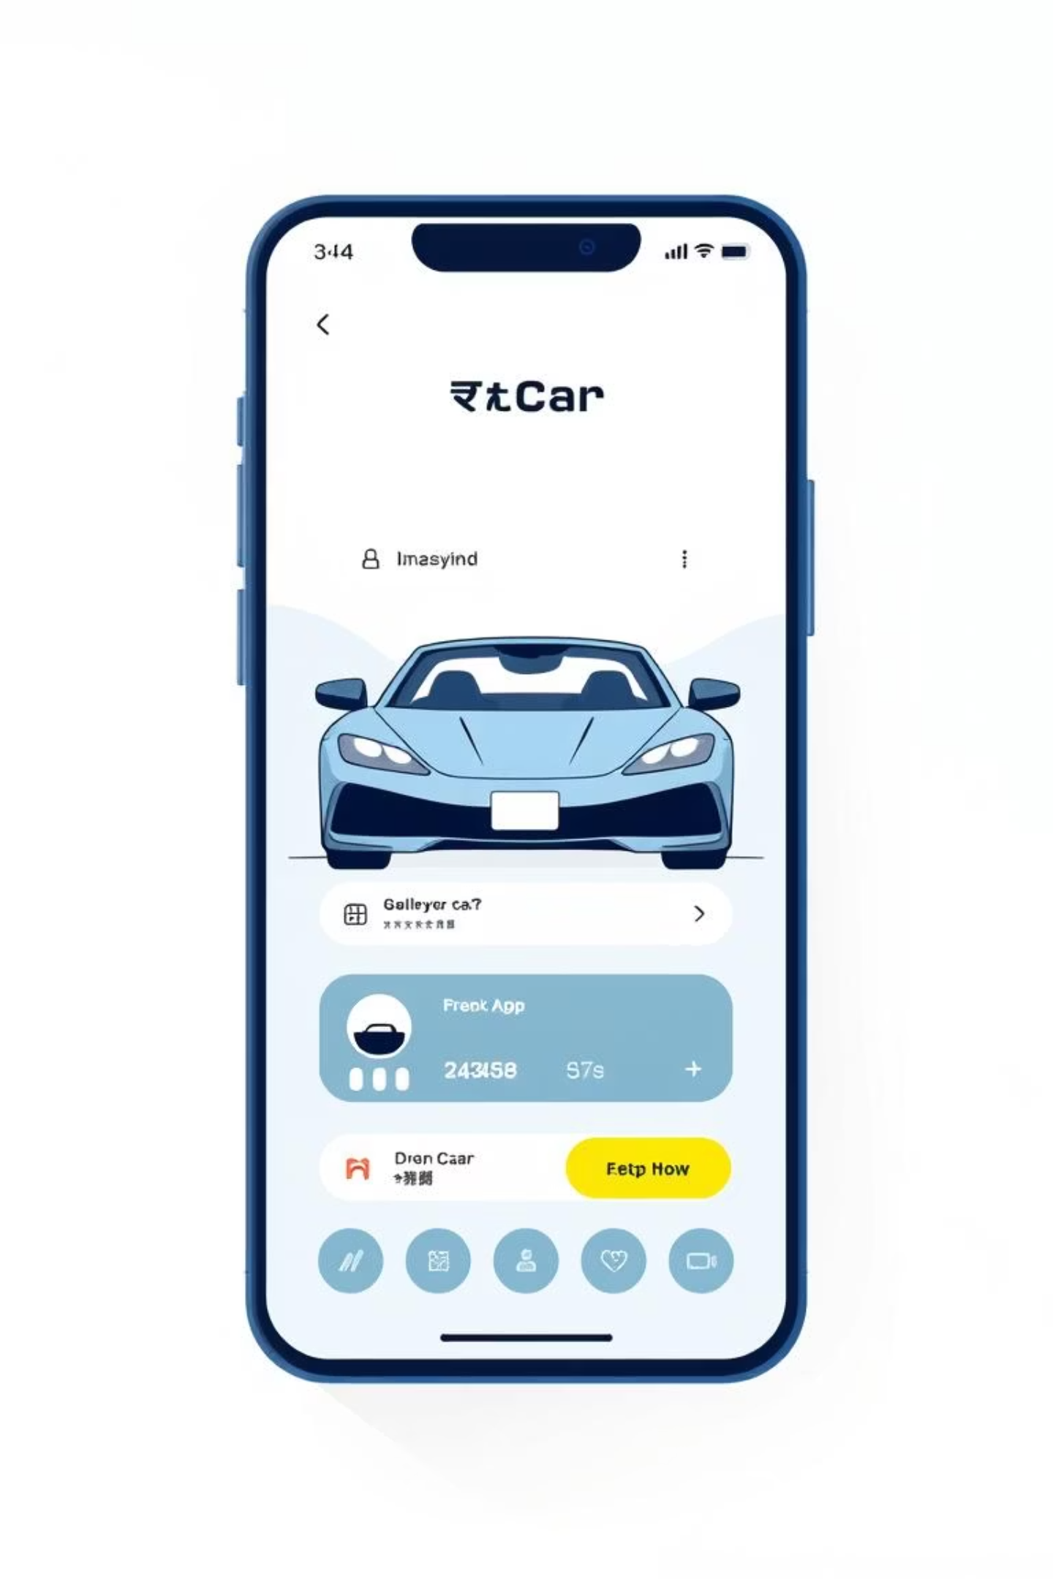
PrimeDrive: Revolutionising Car Rentals with Smart Technology
Discover how PrimeDrive transforms the traditional car rental experience into a seamless, digital journey.

Slide 2

Project Overview: Digital Transformation of Car Rentals
PrimeDrive is a web-based system designed to digitise the entire car rental workflow, eliminating manual procedures and inherent inefficiencies.
The Problem
The Solution
Excessive paperwork and manual data entry
Intuitive online platform for users
Lack of centralised tracking and oversight
Centralised management panel for administrators
High potential for human error
Automated processes from booking to vehicle return
Time-consuming processes for both customers and staff
Enhanced data accuracy and operational efficiency

Slide 3




Robust System Design & Architecture
PrimeDrive is built on a modern, scalable technology stack ensuring reliability and performance.
Frontend
Backend
Database
HTML5, CSS3, and Bootstrap 5 for a responsive, user-friendly interface across all devices.
Node.js and Express.js handle server-side logic and API interactions, ensuring swift data processing.
MySQL selected for its proven data security, scalability, and high reliability.

Slide 4

Core Entities: The Foundation of PrimeDrive
The system's backbone relies on well-defined relationships between key entities, ensuring seamless data management.
User
Customer
Registers, authenticates, and interacts with cars and services.
Holds profiles, bookings, and links to user accounts.
Car
Admin
Contains attributes, availability, and ties to customers and admins.
Manages cars, users, and enforces system relationships.
Each entity plays a critical role in defining the system's functionality and user interactions.

Slide 5





Key Methods: Driving System Functionality
The class diagram illustrates the primary methods that orchestrate user interactions and
system processes within PrimeDrive.
Authentication
Booking Control
signup() and login()
for secure access
approveBooking()
manages reservation
flow
Pricing Engine
System
Orchestration
computePrice()
calculates fare and
fees
Methods interact
across service
classes
These methods ensure secure authentication, efficient booking management, and accurate pricing.

Slide 6

Key Objectives & Features
PrimeDrive is built around critical features designed to enhance user experience and administrative control.
Secure Authentication
Industry-standard password encryption to protect user data and ensure privacy.
Dynamic Search & Filters
Real-time car listings with flexible filters by brand, type, and price for efficient browsing.
Automated Booking
Automatic availability checks and transparent cost calculations for hassle-free reservations.
Admin Dashboard
A robust panel offering real-time statistics and oversight of vehicles, users, and bookings.

Slide 7

Agile Development & User Experience
Our development process prioritised flexibility
and user-centric design.
Agile Development Process
Methodology: Agile (Scrum) was adopted
for iterative development.
Tools: Jira used for comprehensive
management of Sprints and User Stories.
Benefits: Enabled rapid iteration, continuous feedback, and efficient adaptation to evolving requirements.

Slide 8
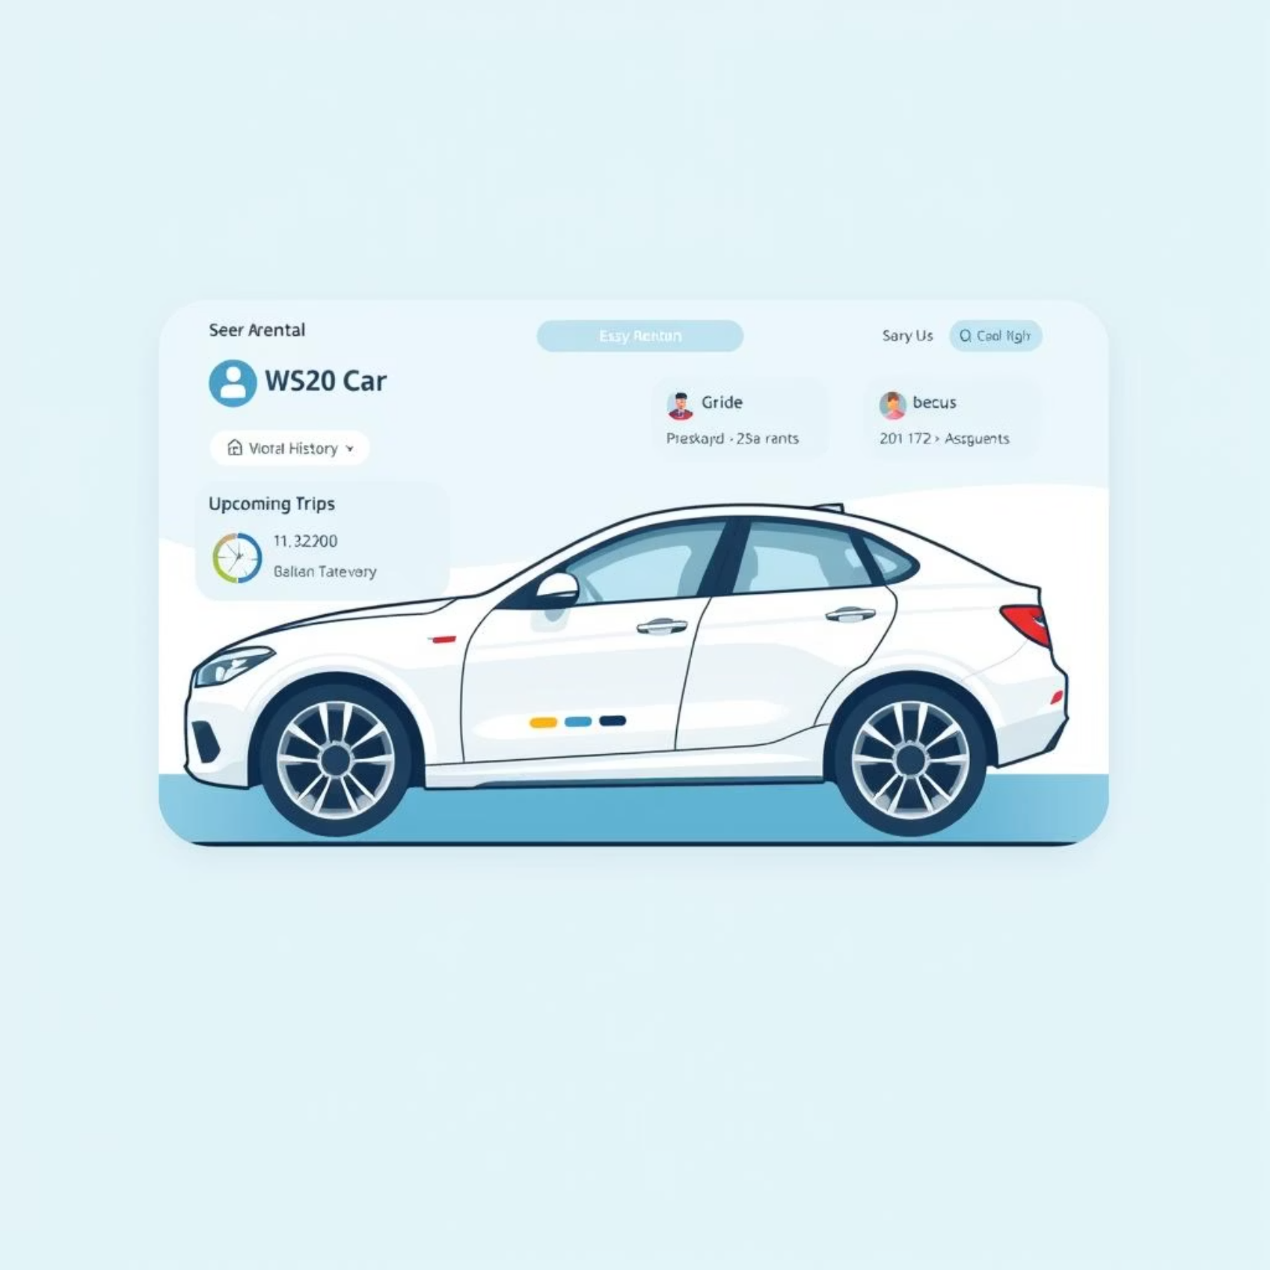
Intuitive User Experience
The PrimeDrive user portal is designed for clarity and convenience, offering personalised insights.
Personalised Overview
Rental History: Users can easily access
past rental details.
Upcoming Trips: A clear view of future
bookings and schedules.
Intuitive Interface: Designed to be simple, clean, and highly functional for all users.

Slide 9

Comprehensive Testing & Project Resources
Ensuring system stability and providing accessible project documentation.
Comprehensive Testing
A total of 15 rigorous test cases (TC-01 to TC-15) were designed and executed to confirm system stability, reliability, and functionality across all modules.
Project Access
The complete codebase is available on the GitHub repository for transparency and collaborative development. The live web application can be accessed via a dedicated URL.

Slide 10



PrimeDrive: The Future of Car Rental
PrimeDrive is poised to redefine the car rental industry through innovation, efficiency, and a superior user experience.
Streamlined operations for businesses.
Effortless booking for customers.
Secure and reliable platform.
Scalable for future growth and expansion.
GitHub Repository
Explore the full codebase and project history:
https://github.com/M-Yahya-Sohail/PrimeDrive-Project
Live Web Application
Experience PrimeDrive in action: https://primedrive-pk.netlify.app/

